Slide 1
RICH Control Manual
Valery Kubarovsky
January 23, 2024

Slide 2
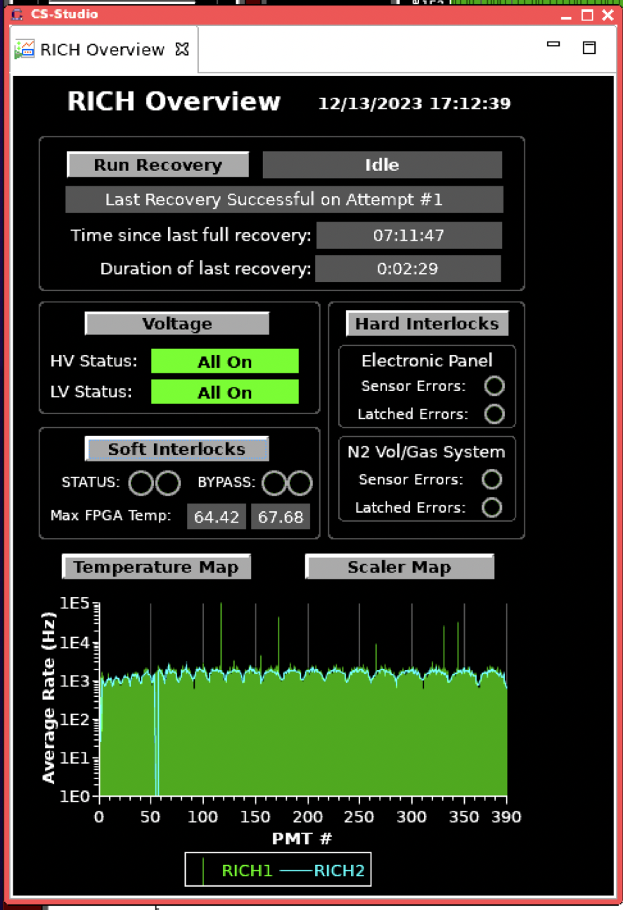
RICH front-end is sitting in the beam of the secondary particles. The radiation damage causes the malfunction of FE . Dead tiles appear. The damage is not permanent. It can be recovered by switching LV OFF/ON or reloading the RICH front-end FPGA
We don’t need to perform the RICH full recovery daily any more. DAQ is reloading FPGA memory during prestart automatically
In case you got RICH alarm do the following:
Continue data taking if DAQ is working.
Start new run with CANCEL-RESET
With high probability the problem will be fixed automatically
If the problem is not solved do RICH full recovery.
If it does not not help call RICH expert

Slide 3
RICH mainframe remote reboot
In case of communication lost with the RICH mainframe try to reboot it remotely
To reboot only the CPU: caenhvReset.py --soft hvrich1 (sector 4)
caenhvReset.py --soft hvrich2 (sector 1)
To power cycle the whole thing, causing all voltages to go to zero: caenhvReset.py --hard hvrich1 (sector 4)
caenhvReset.py --hard hvrich2 (sector 1)

Slide 4
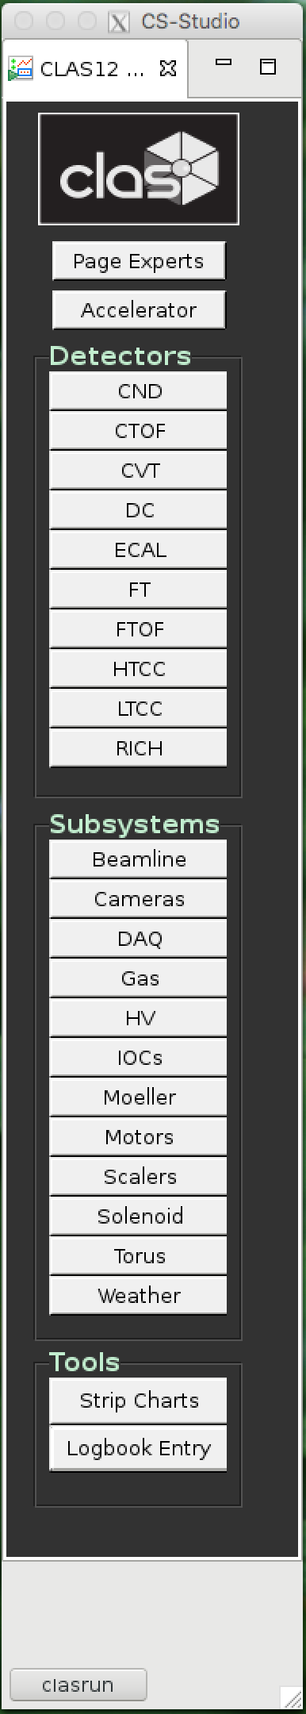
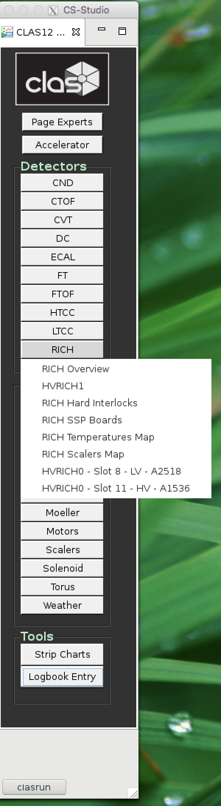
RICH GUI overview
Press RICH on clascss menu
Chose RICH Overview

Slide 5
RICH GUI
Voltage
Control RICH HV and LV
Temperature Map
Shows the temperature of the RICH electronic boards
Scaler Map
Presents the rate of the MAPMT pixels
Hard Interlock
Control the RICH interlock
Soft Interlock
Control the max temperature of the FPGA chips

Slide 6
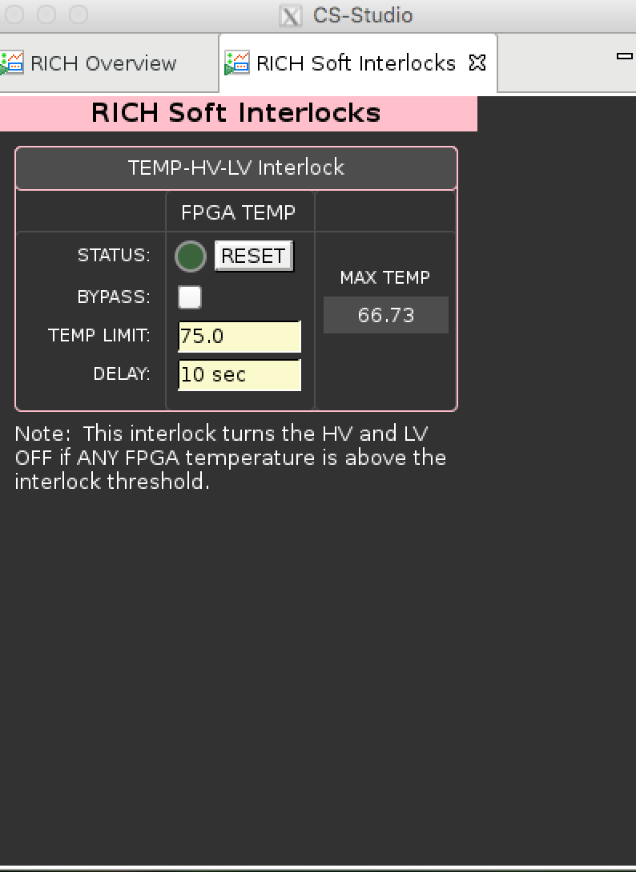
Soft Interlock
Max temperature has to be less than 75 C
Reset the interlock if necessary

Slide 7
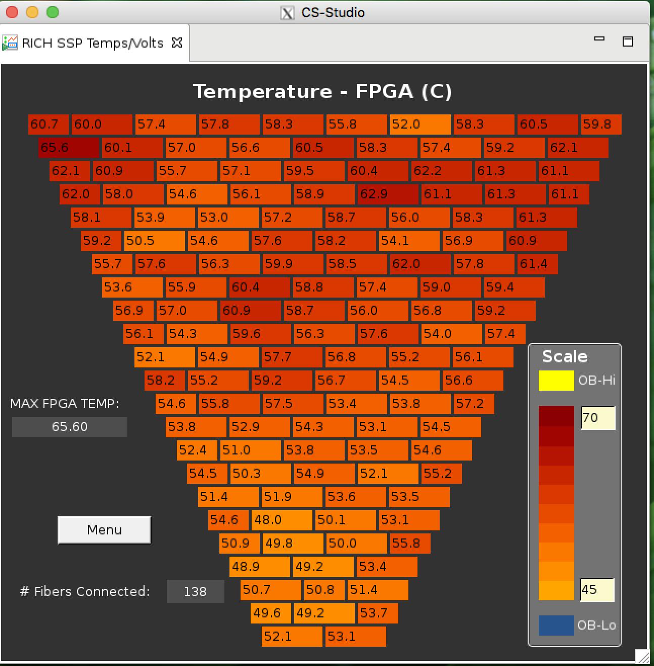
Temperature Map
Max temperature has
to be less than 75 C
Soft interlock switches off
The RICH HV and LV if t>75C⁰
All tiles have to be present
except Tile 21 in sector 1

Slide 8
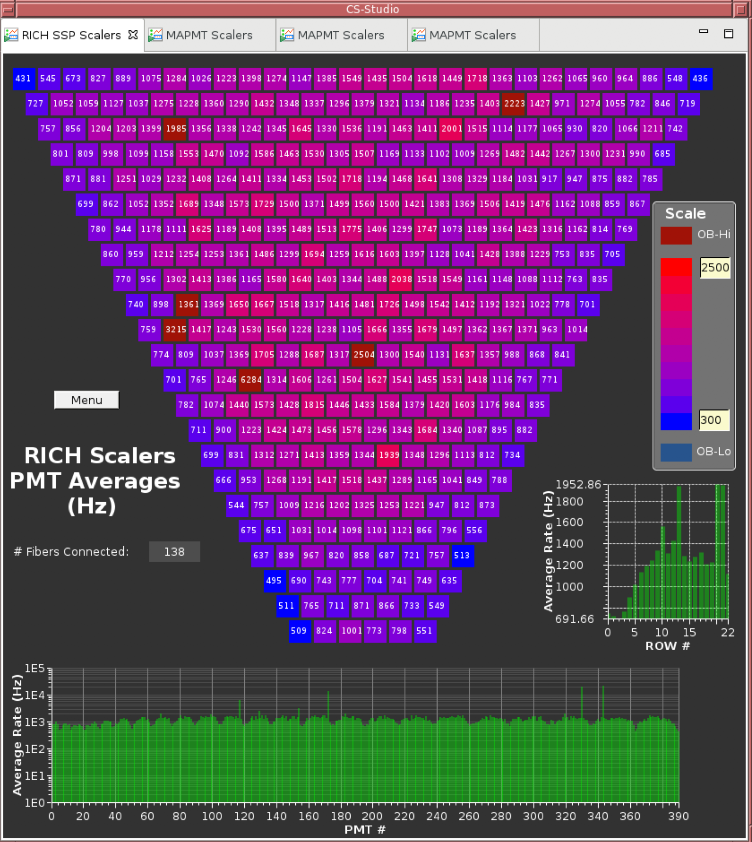
RICH scalers
The plot presents the
average rate of the MAPMT
pixels
ALL MAPMTs have to
be present except Tile 21
in sector 1

Slide 9
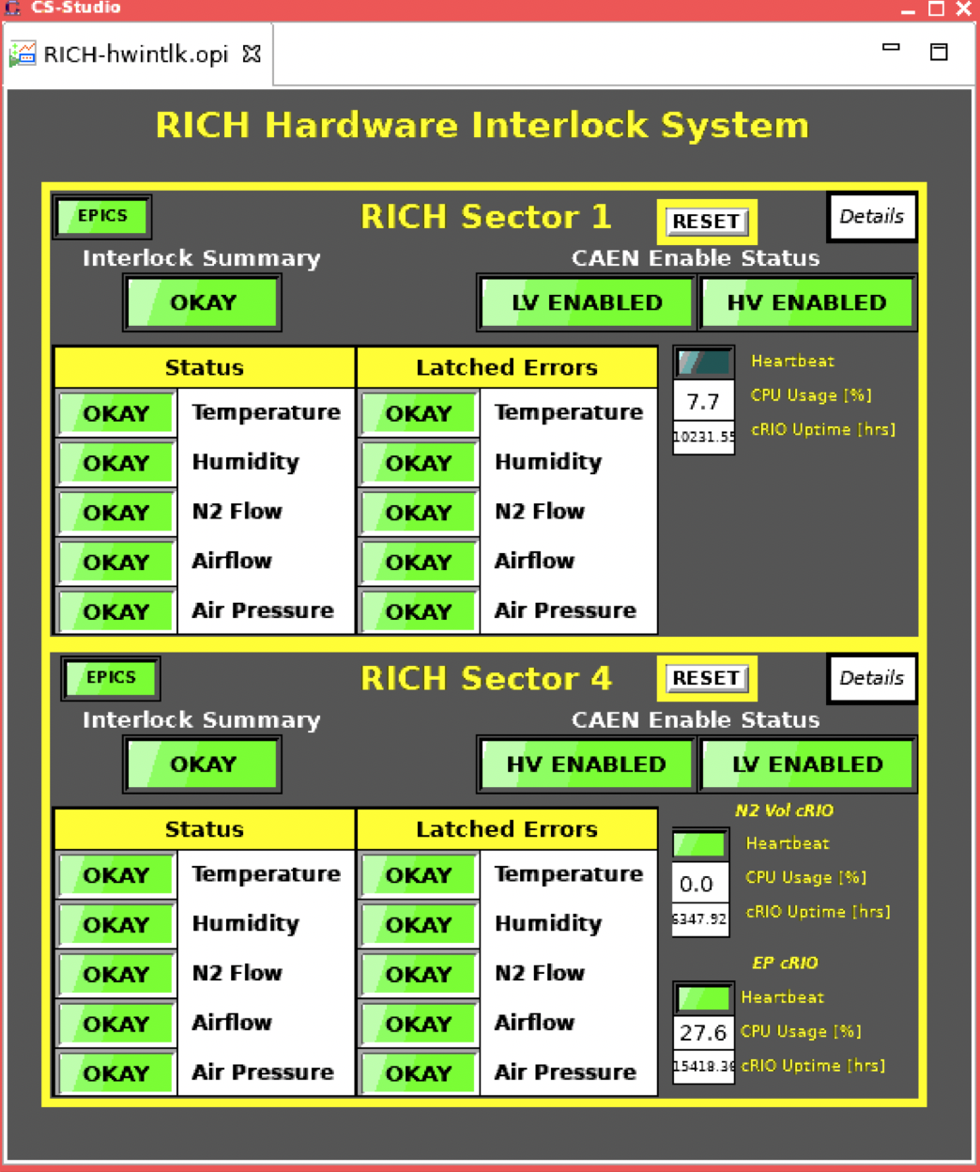
Hard Interlock
controls the
temperature
and humidity
inside the
RICH detector
Press this button
to view the sector 1
panel
Press this button
to view the sector 4
panel

Slide 10
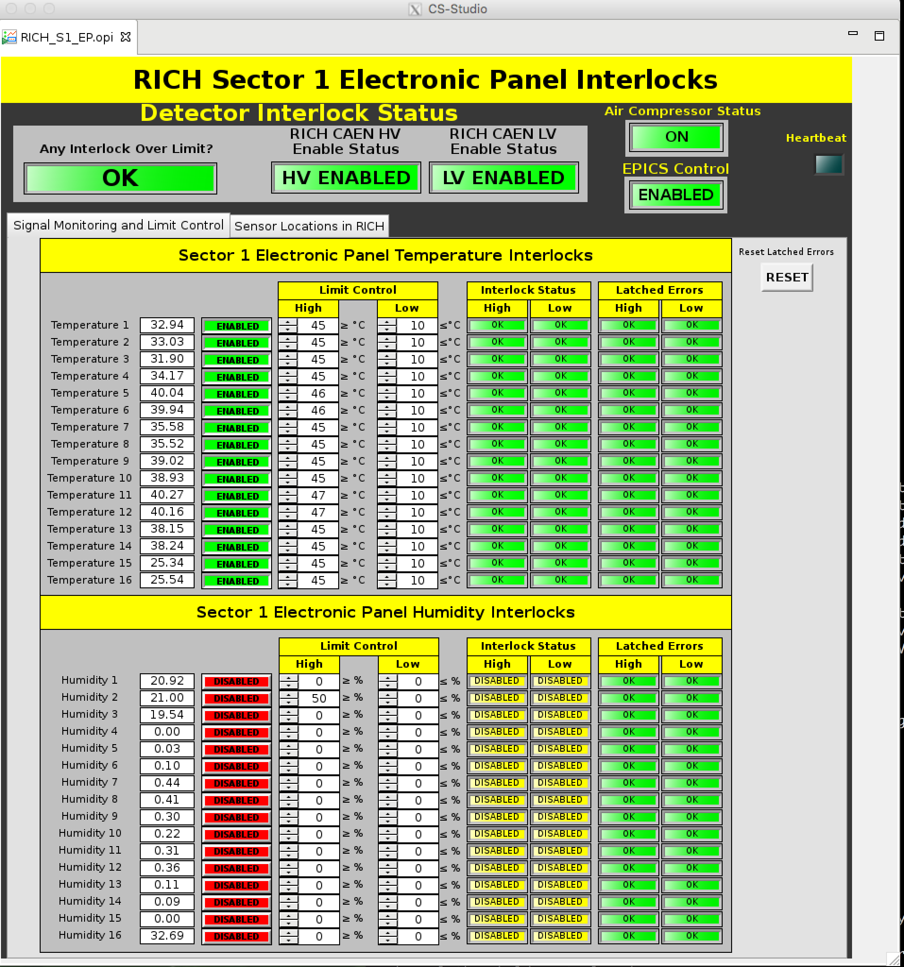
Electronic Volume Interlock
Check the temperature and humidity

Slide 11
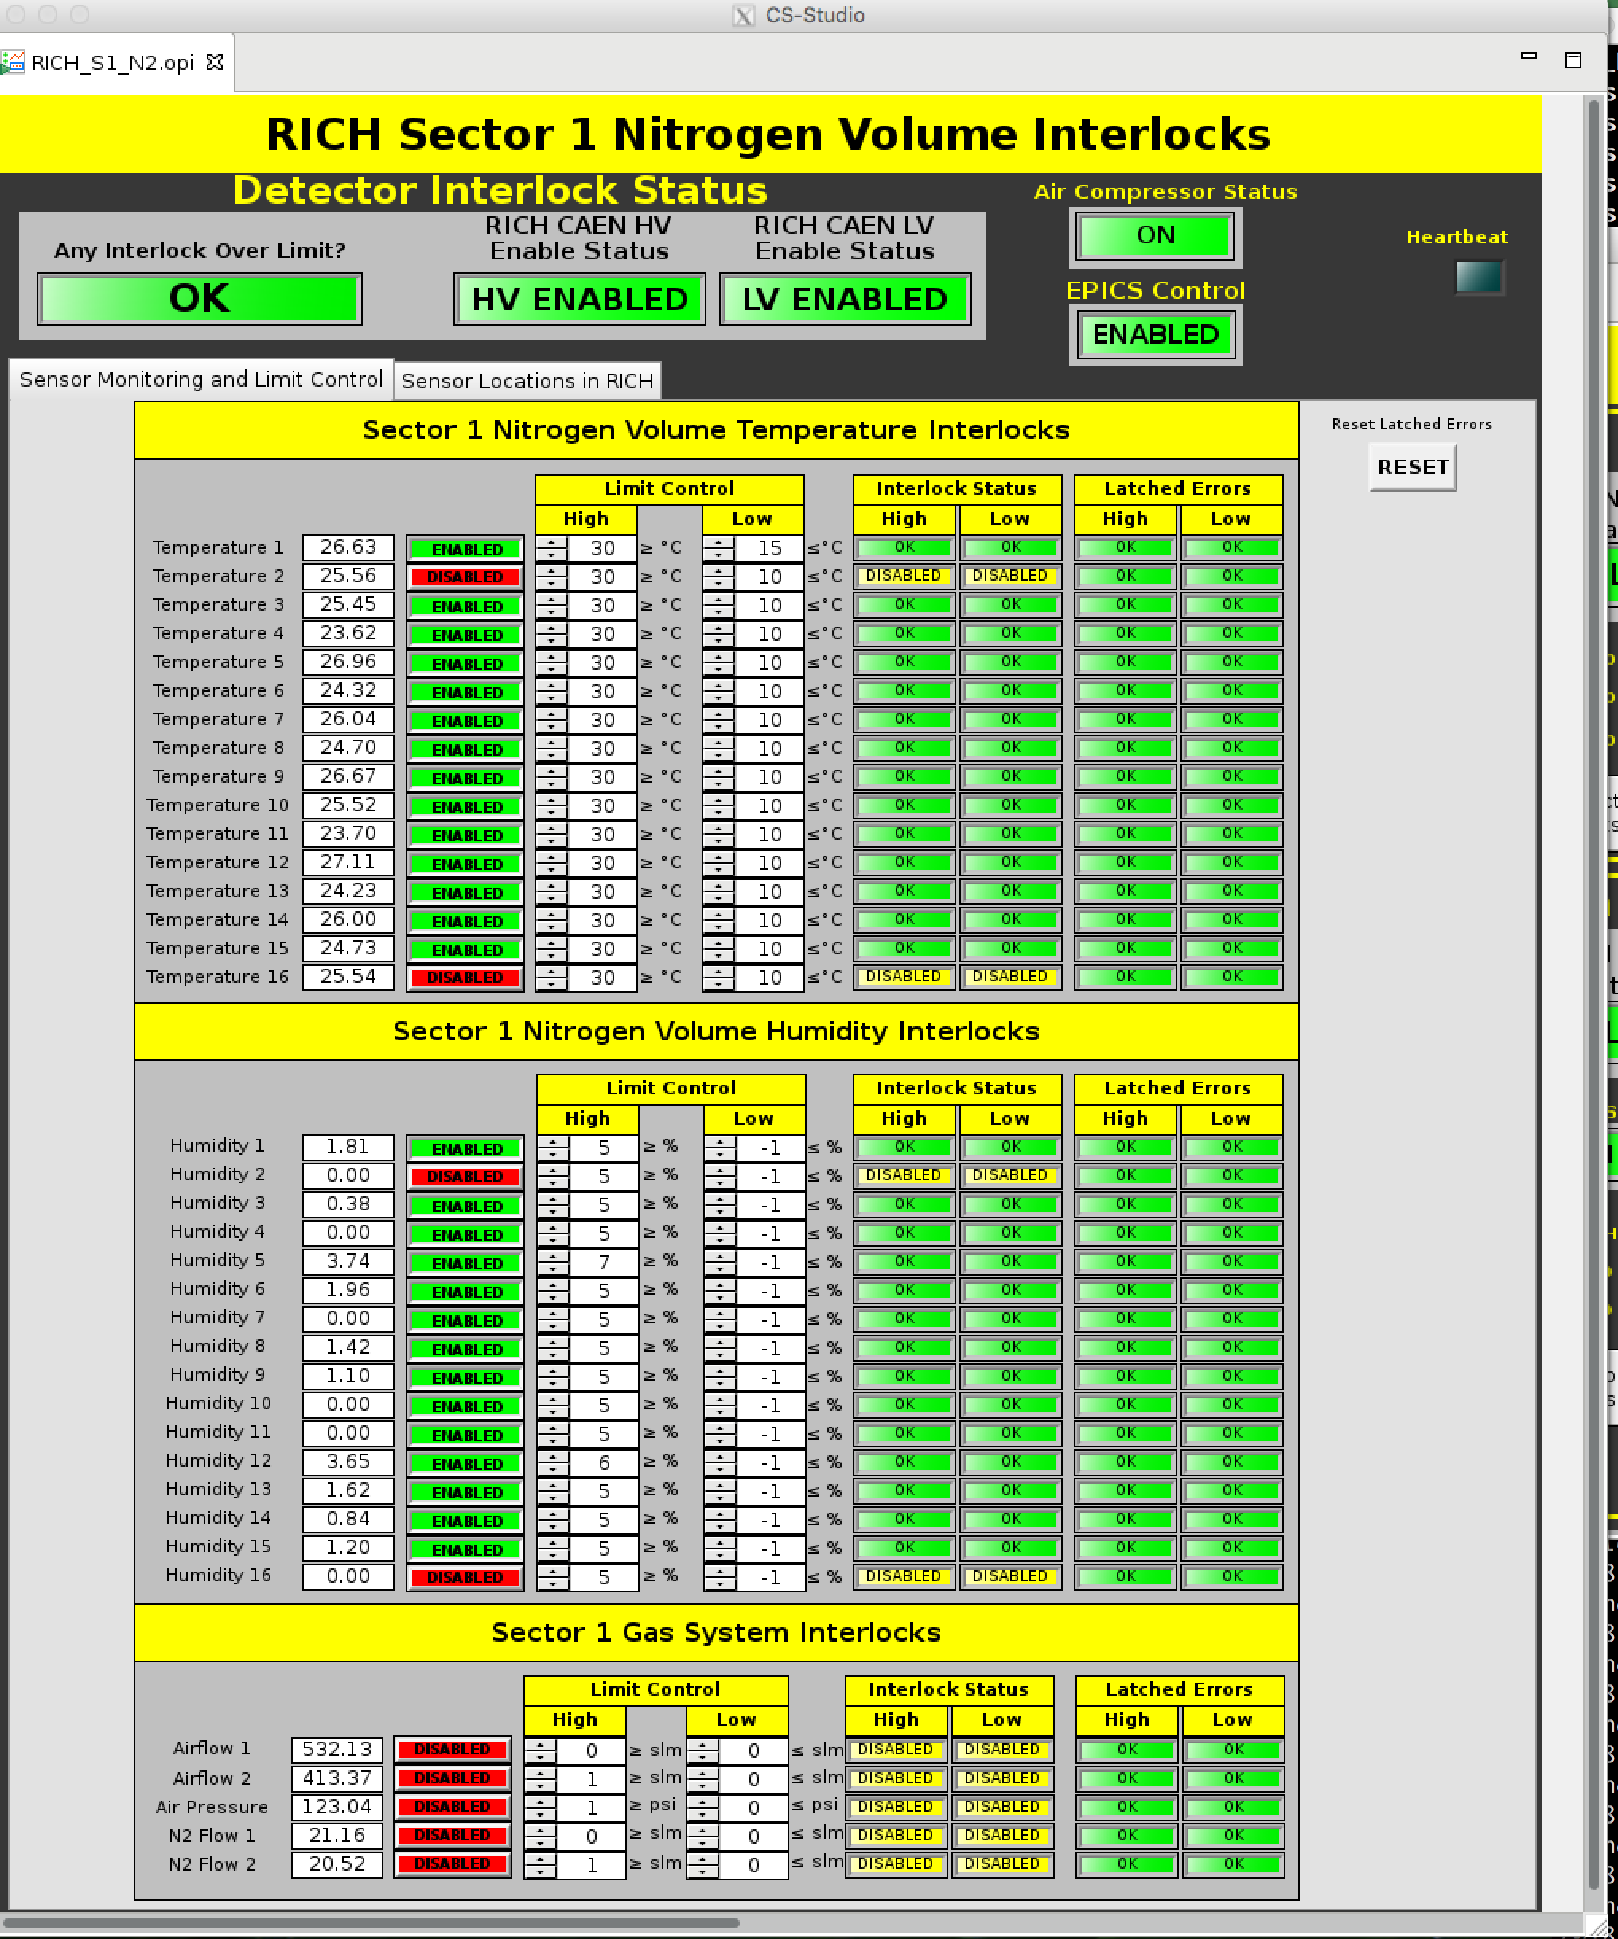
Nitrogen Volume Interlock
Check the temperature and humidity

